Slide 1

Machine Learning 101
Session 4: K Means Clustering
Nafis Neehal, Lecturer, CSE, DIU.
Cognota.ai

Slide 2
Contents
What is Unsupervised Problem
Concept of Clustering
Implementation on a Simple Dataset
Implement on IRIS
Cognota.ai

Slide 3
Clustering
Collection of entities exhibiting same pattern
Cognota.ai

Slide 4
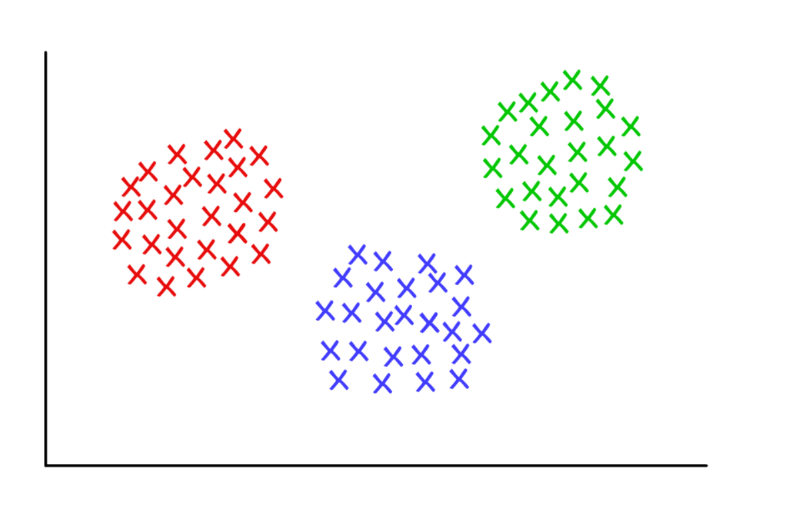
Clustering Concept (Based on Distance)
Cognota.ai

Slide 5
Hypothetical Dataset
X | Y
2 | 4
2 | 3
5 | 2
6 | 2
5 | 2.5
2.5 | 3.5
Cognota.ai

Slide 6
Plot of the Dataset
Cognota.ai

Slide 7
Algorithm
Algorithm:
Let, number of clusters = k
Initialize k centroids randomly, one for each cluster
Now, consider each data point p(x, y)
Find distance among p and each of the centroids
Assign the point to the closest cluster
Update all cluster centroid after each data point to cluster assignment
Repeat until finished
Cognota.ai

Slide 8
Example Worked Out
Let K = 2
So we will have 2 clusters
Each cluster will have 1 centroid.
Let centroids be, c1, c2
Initialize (chose 2 training data as two centroids):
C1 = (2, 4)
C2 = (5, 2)
Cognota.ai

Slide 9
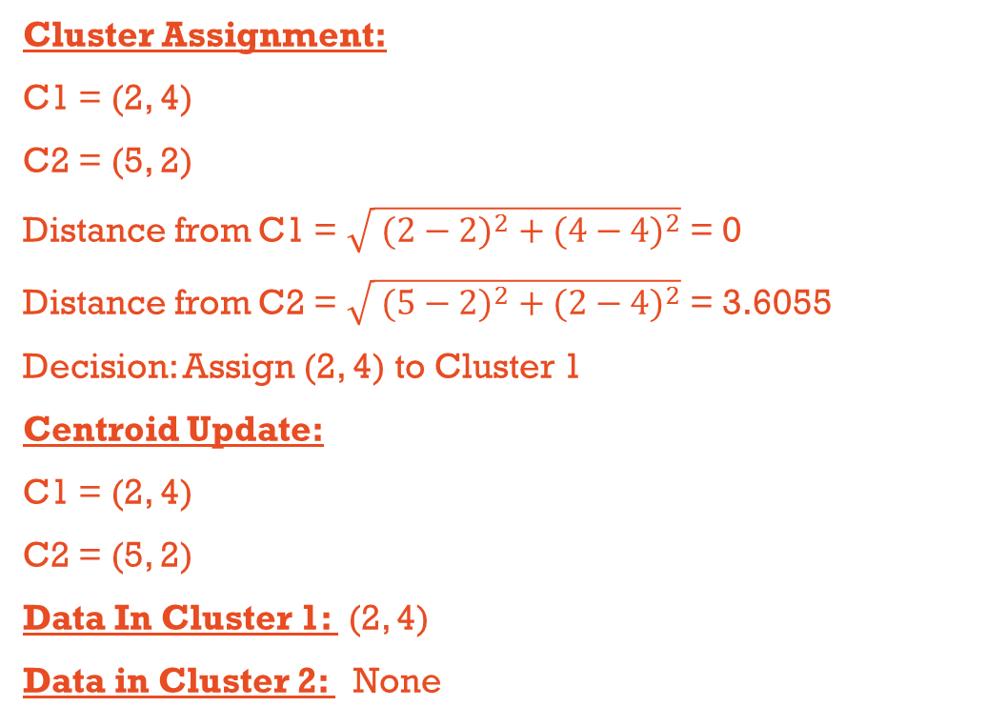
First Training Point (2, 4)
Cluster Assignment:
C1 = (2, 4)
C2 = (5, 2)
Distance from C1 = $\sqrt{{ (2−2)}^{2} +{ (4−4)}^{2}}$ = 0
Distance from C2 = $\sqrt{{ (5−2)}^{2} +{ (2−4)}^{2}}$ = 3.6055
Decision: Assign (2, 4) to Cluster 1
Centroid Update:
C1 = (2, 4)
C2 = (5, 2)
Data In Cluster 1: (2, 4)
Data in Cluster 2: None
Cognota.ai

Slide 10
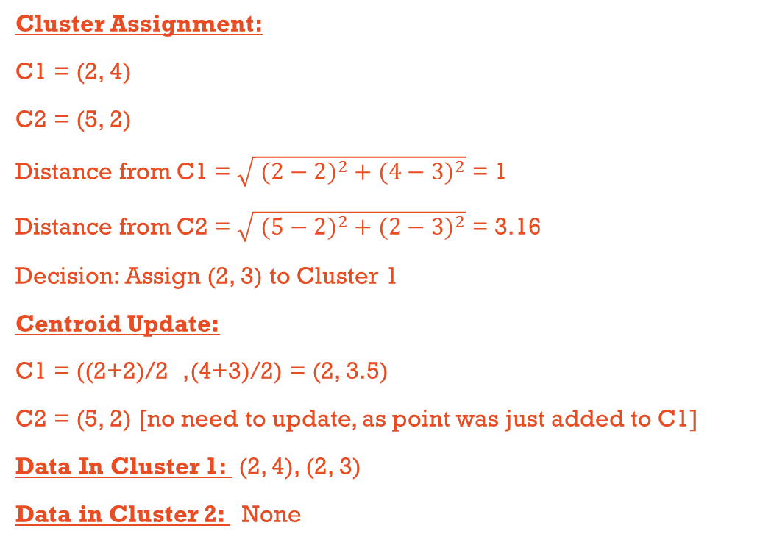
Second Training Point (2, 3)
Cluster Assignment:
C1 = (2, 4)
C2 = (5, 2)
Distance from C1 = $\sqrt{{ (2−2)}^{2} +{ (4−3)}^{2}}$ = 1
Distance from C2 = $\sqrt{{ (5−2)}^{2} +{ (2−3)}^{2}}$ = 3.16
Decision: Assign (2, 3) to Cluster 1
Centroid Update:
C1 = ((2+2)/2 ,(4+3)/2) = (2, 3.5)
C2 = (5, 2) [no need to update, as point was just added to C1]
Data In Cluster 1: (2, 4), (2, 3)
Data in Cluster 2: None
Cognota.ai

Slide 11
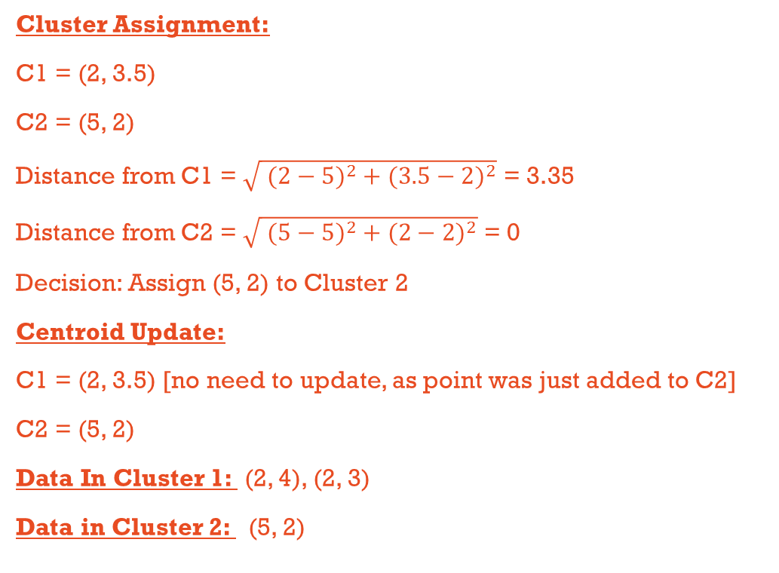
Third Training Point (5, 2)
Cluster Assignment:
C1 = (2, 3.5)
C2 = (5, 2)
Distance from C1 = $\sqrt{{ (2−5)}^{2} +{ (3.5−2)}^{2}}$ = 3.35
Distance from C2 = $\sqrt{{ (5−5)}^{2} +{ (2−2)}^{2}}$ = 0
Decision: Assign (5, 2) to Cluster 2
Centroid Update:
C1 = (2, 3.5) [no need to update, as point was just added to C2]
C2 = (5, 2)
Data In Cluster 1: (2, 4), (2, 3)
Data in Cluster 2: (5, 2)
Cognota.ai

Slide 12
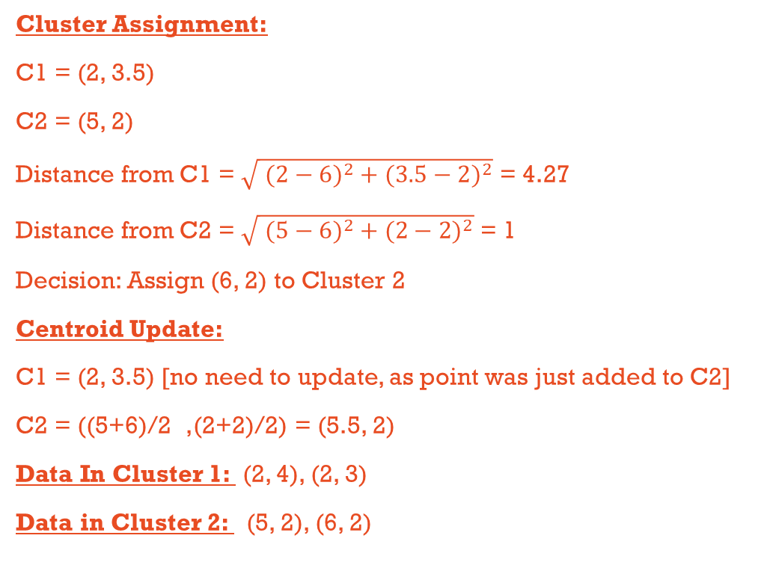
Fourth Training Point (6, 2)
Cluster Assignment:
C1 = (2, 3.5)
C2 = (5, 2)
Distance from C1 = $\sqrt{{ (2−6)}^{2} +{ (3.5−2)}^{2}}$ = 4.27
Distance from C2 = $\sqrt{{ (5−6)}^{2} +{ (2−2)}^{2}}$ = 1
Decision: Assign (6, 2) to Cluster 2
Centroid Update:
C1 = (2, 3.5) [no need to update, as point was just added to C2]
C2 = ((5+6)/2 ,(2+2)/2) = (5.5, 2)
Data In Cluster 1: (2, 4), (2, 3)
Data in Cluster 2: (5, 2), (6, 2)
Cognota.ai

Slide 13
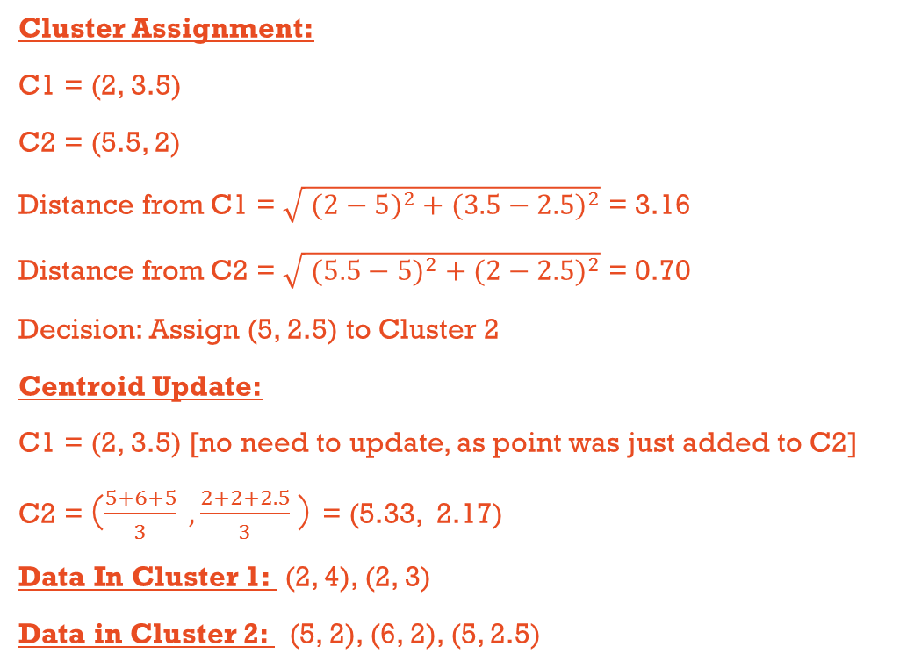
Fifth Training Point (5, 2.5)
Cluster Assignment:
C1 = (2, 3.5)
C2 = (5.5, 2)
Distance from C1 = $\sqrt{{ (2−5)}^{2} +{ (3.5−2.5)}^{2}}$ = 3.16
Distance from C2 = $\sqrt{{ (5.5−5)}^{2} +{ (2−2.5)}^{2}}$ = 0.70
Decision: Assign (5, 2.5) to Cluster 2
Centroid Update:
C1 = (2, 3.5) [no need to update, as point was just added to C2]
C2 = ($\frac{5+6+5}{3} , \frac{2+2+2.5}{3}$) = (5.33, 2.17)
Data In Cluster 1: (2, 4), (2, 3)
Data in Cluster 2: (5, 2), (6, 2), (5, 2.5)
Cognota.ai

Slide 14
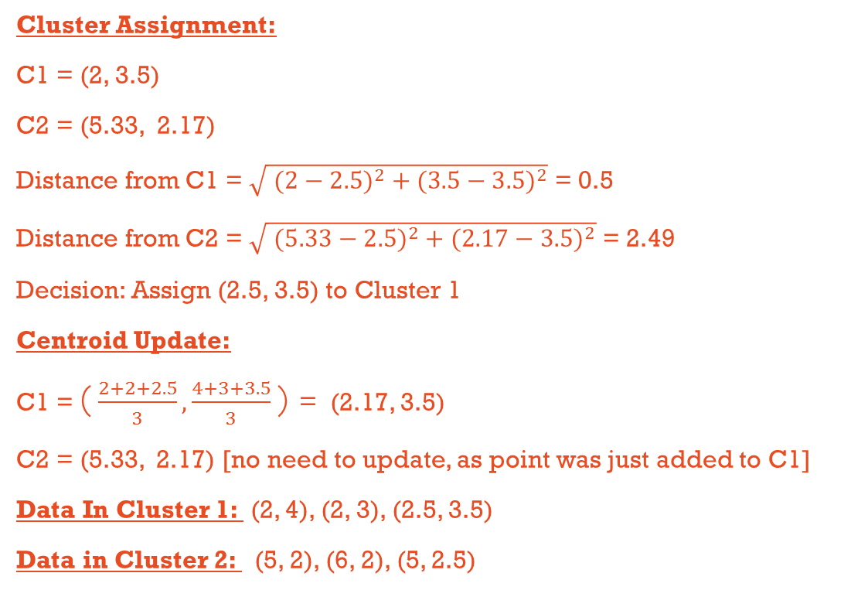
Sixth Training Point (2.5, 3.5)
Cluster Assignment:
C1 = (2, 3.5)
C2 = (5.33, 2.17)
Distance from C1 = $\sqrt{{ (2−2.5)}^{2} +{ (3.5−3.5)}^{2}}$ = 0.5
Distance from C2 = $\sqrt{{ (5.33−2.5)}^{2} +{ (2.17−3.5)}^{2}}$ = 2.49
Decision: Assign (2.5, 3.5) to Cluster 1
Centroid Update:
C1 = ($\frac{2+2+2.5}{3}, \frac{4+3+3.5}{3}$) = (2.17, 3.5)
C2 = (5.33, 2.17) [no need to update, as point was just added to C1]
Data In Cluster 1: (2, 4), (2, 3), (2.5, 3.5)
Data in Cluster 2: (5, 2), (6, 2), (5, 2.5)
Cognota.ai

Slide 15
Final Plot
Cognota.ai

Slide 16
Task Dataset
We will use the popular IRIS Dataset.
150 Samples
3 Classes (setosa, versicolor, virginica)
50 samples to each class
Use 100 Data Samples (it has to be random) as training and rest 50 Data Samples as training
Cognota.ai

Slide 17
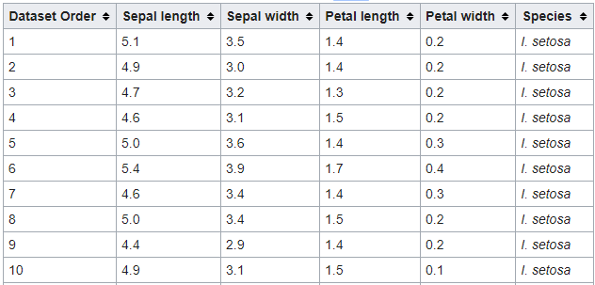
Dataset Sample
Cognota.ai

